Slide 1
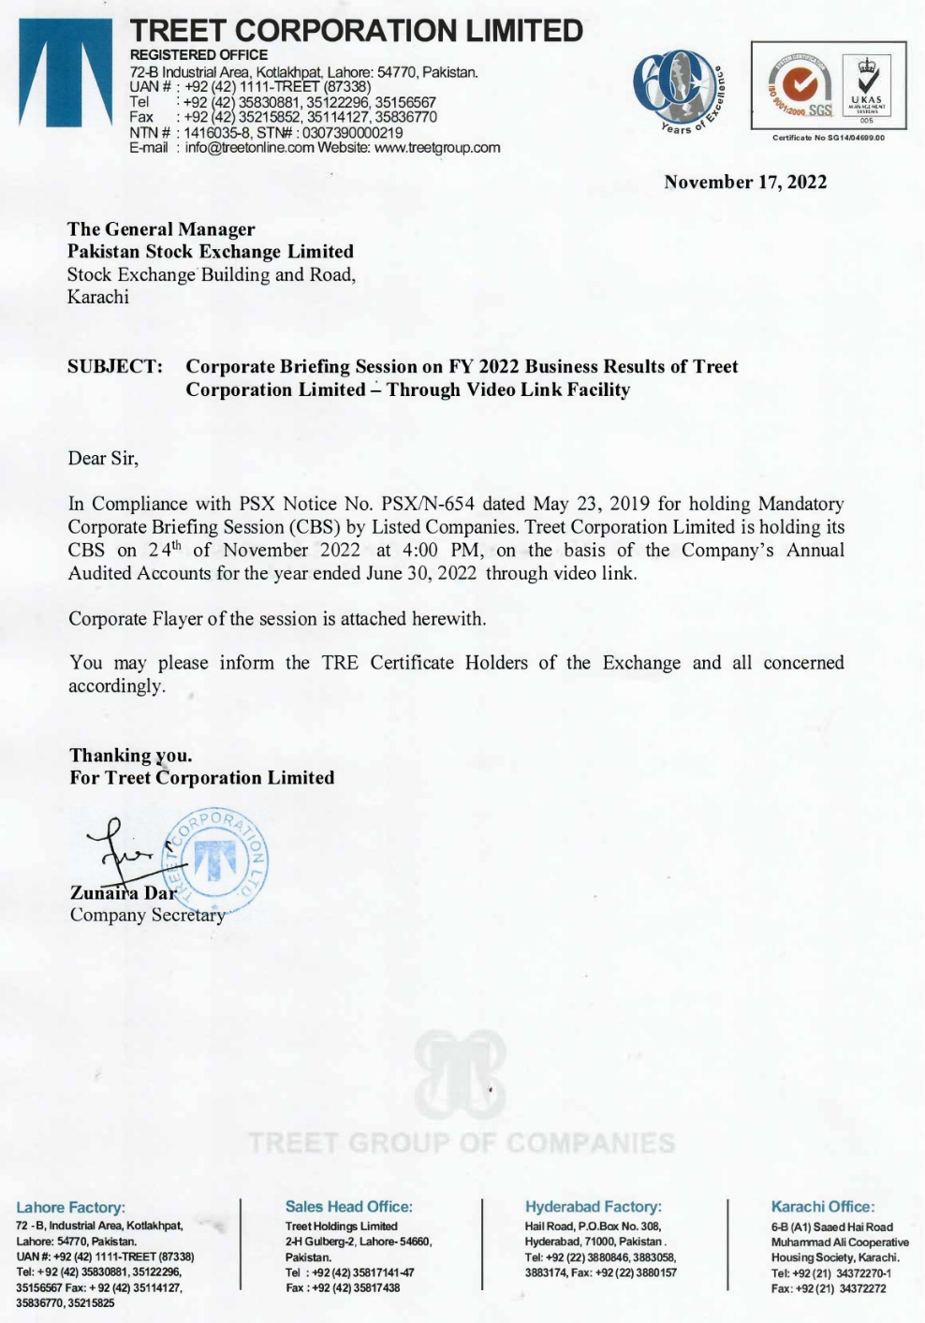
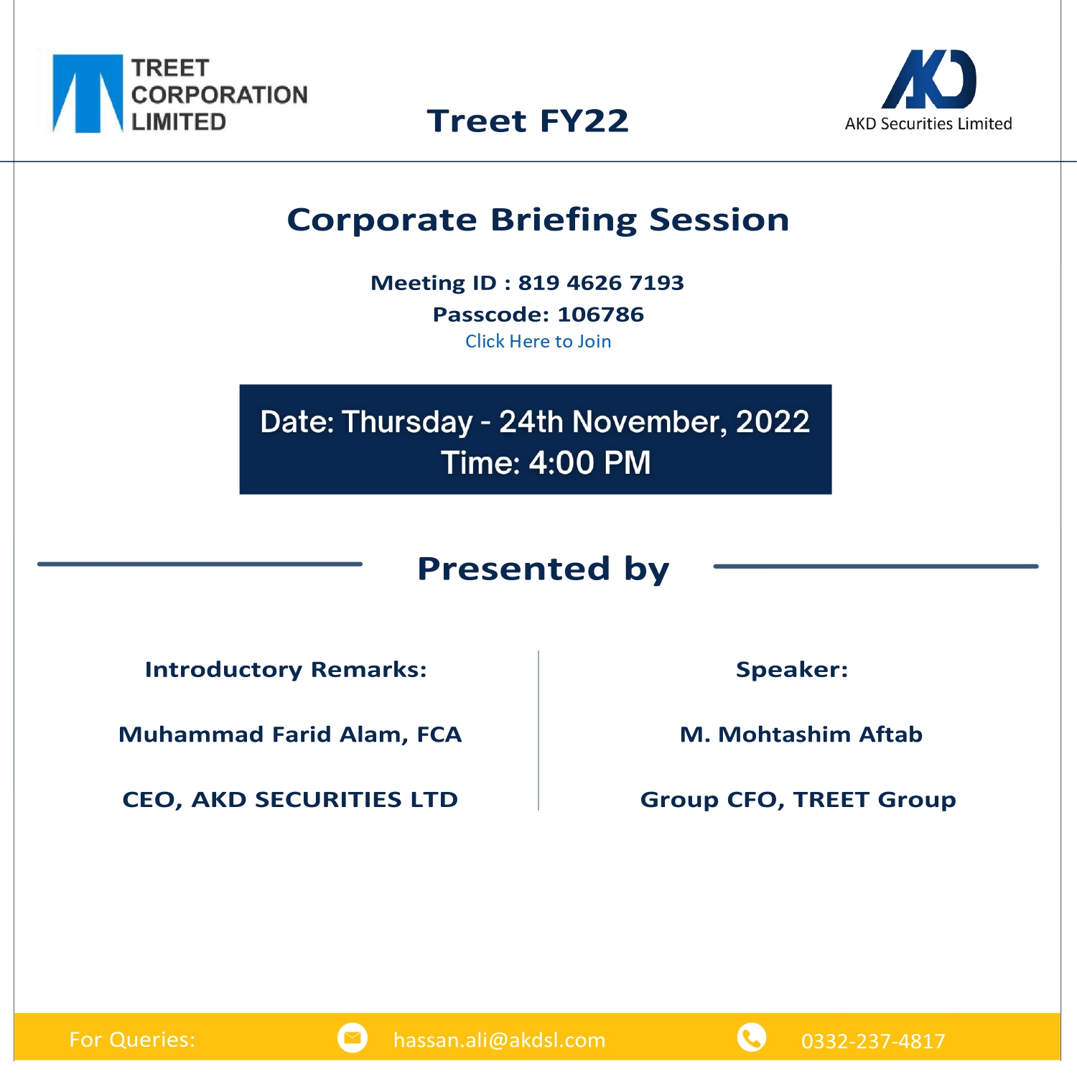

Slide 2

Treet Group Profile
Group Companies & Business Divisions

Slide 3


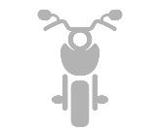



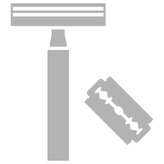
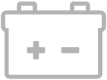

Hemodialysis Concentrate
2016
Corrugated Packaging
2007
Radiators, Metal Sheets
& Exhausts Systems
1979
Motorcycles
2009
Chemical Trading
2017
Soaps
1996
Batteries
2018
Blades & Razors
1952
The Tree of TREET FAMILY
FROM BLADES TO BATTERIES & MUCH MORE…
10+ BUSINESSES IN 6 INDUSTRIES

Slide 4
Shareholding Pattern
June 30, 2022
Paid Up capital | Total No. Shares | Free Float | % of Free Float
1,748.34mn | 174.83mn | 76.52mn | 44%
 | No. of Share | % of Shareholding
Directors | 69,199,850 | 39.58%
Associated Companies | 8,887,958 | 5.08%
NIT & ICP | 11,913,762 | 6.81%
Foreign Companies | 150,000 | 0.09%
Banks, DFI, Insurance | 7,001,361 | 4.00%
Joint Stock Companies | 14,709,439 | 8.41%
Mutual & Pension Fund | 7,305,672 | 4.18%
Federal Board of Revenue | 274,134 | 0.16%
Modaraba’s | 1,000 | 0.01%
Individuals | 54,886,559 | 31.39%
Others | 504,587 | 0.29%
Total | 174,834,322 | 100.00%

Slide 5
Sponsors Background & Board Composition
Syed Shahid Ali is the sponsor Director & major shareholder of Treet Corporation Limited
He is the CEO of Treet Corporation Limited since 1995
The composition of the Board is as follows:
The total number of Directors are Seven according to following classification
Category | Name of Directors
Independent Director | Dr. Salman Faridi Ms. Sidra Fatima Sheikh
Executive Directors | Syed Shahid Ali Syed Sheharyar Ali Mr. Muhammad Shafique Anjum
Non-Executive Directors | Mr. Imran Azim Mr. Munir Karim Bana
Male Director | 06
Female Director | 01

Slide 6
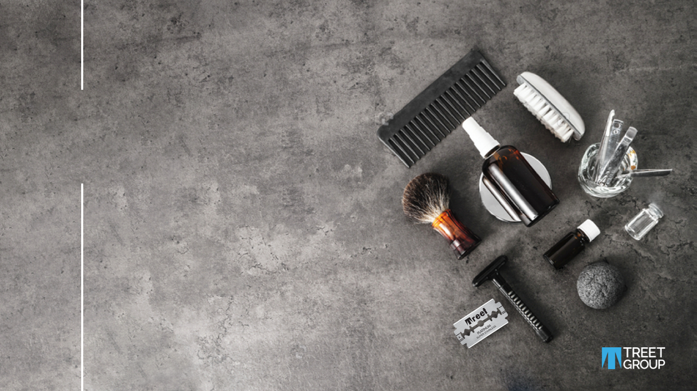
Treet Corporation Limited

Slide 7
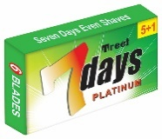
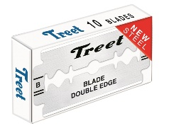
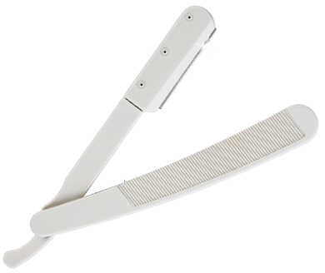
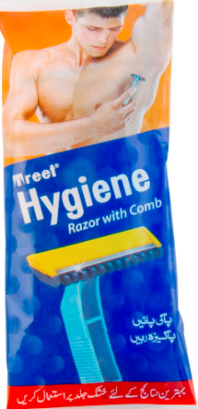
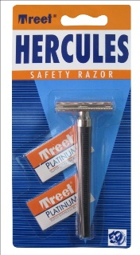
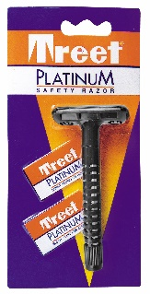
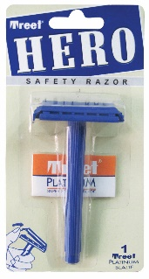
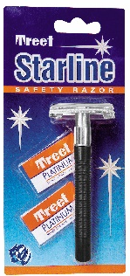
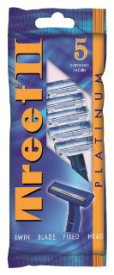
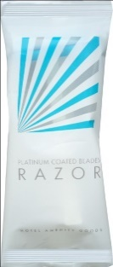
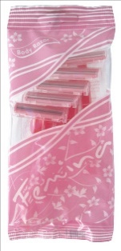
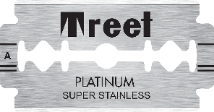
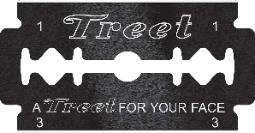
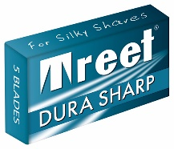
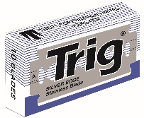
Treet Corporation Limited
We have highest market share of blades & razors in Pakistan and exporting to 45+ countries across the globe in 6 continents.
Domestic Market Share
Export Presence
Production Capacity
We have highest market share of blades & razors in Pakistan
We are exporting to 45+ countries across the globe in 6 continents
Our plants have the capacity to produce 2.23 Billion units (Blades + Razors) per year
01
02
03
04
05
06
Plant Certifications
Production Facilities
Product Range
Our blade & razors manufacturing facilities are ISO 9001:2015 certified since 1997
We have 2 Blades & Razors manufacturing facilities in Pakistan. One in Lahore & the other in Hyderabad
We have 80+ SKUs starting from a wide range of Double Edge Blades to Triple Blade Razors

Slide 8
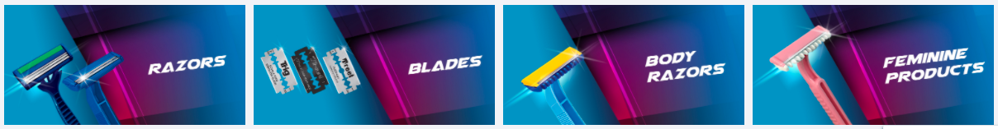
Treet Corporation Limited
TCL is a Treet Group Company which is the only manufacturer & market leader of Shaving Blades & Razors category in Pakistan since 1954.
Revenue
- Local
- Export
7.4 Billion
5.1 Billion
2.3 Billion
Pak
Rupees
Capacity
2.2 Billion
Edges
Resources
2200+
Delighted
Employees
SKUs
80+
Blades
& Razors

Slide 9
Last Two Years Balance Sheet - TREET

Slide 10
Last Two Years Profit or Loss - TREET

Slide 11
First Treet Manufacturing Modaraba
FTMM – Batteries, Soaps & Corrugation

Slide 12
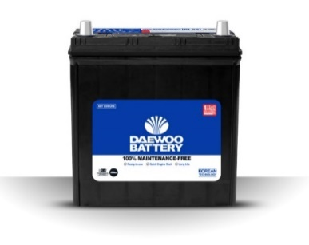
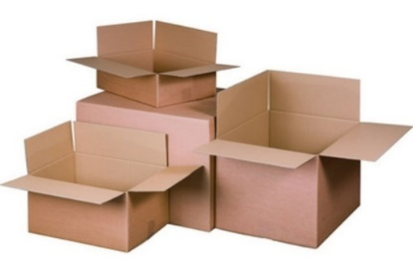
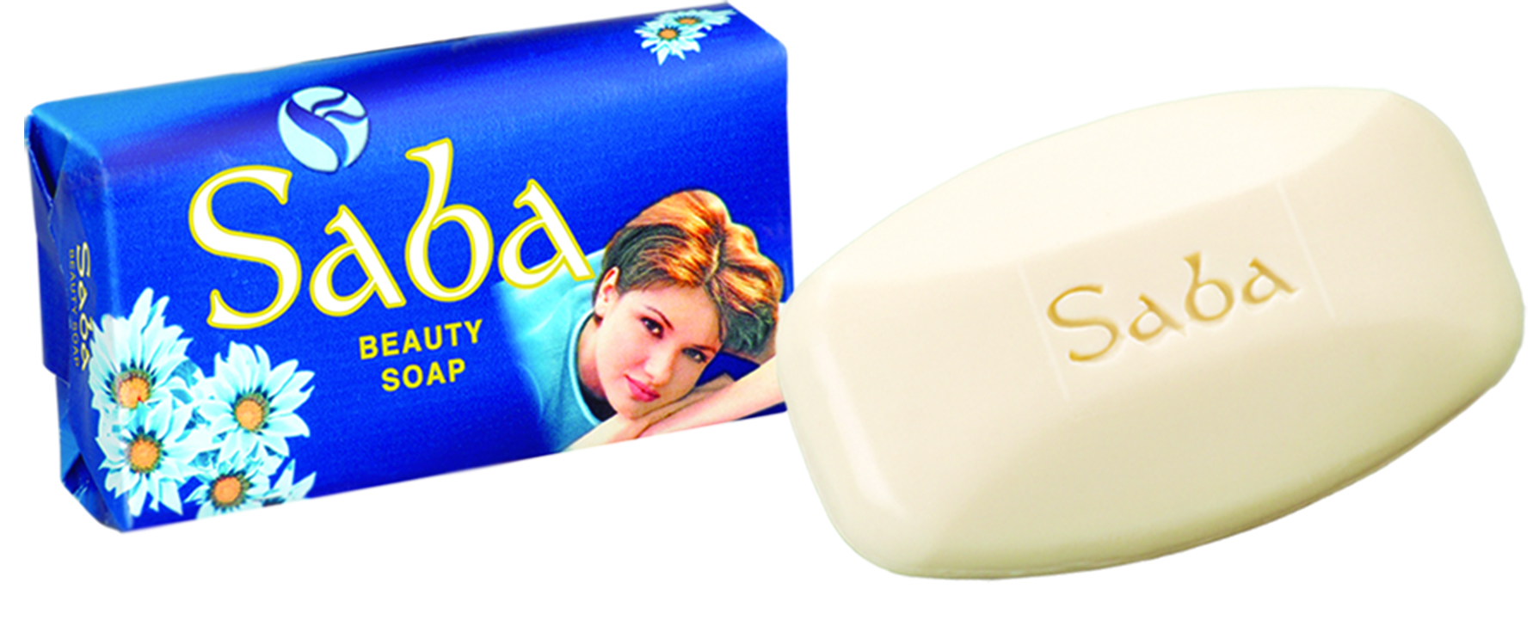
FTMM – First Treet Manufacturing Modaraba
First Treet Manufacturing Modaraba is a multipurpose, perpetual and multidimensional Modaraba managed by Treet Holdings Limited. FTMM is engaged in the manufacturing and sale of lead acid batteries, corrugated boxes and soaps.
Revenue
7.7 Billion
Pak
Rupees
Batteries
1.2 Million
Design
Capacity
Corrugation
30,000
Tons
Installed capacity
Soaps
5,000
Tons
Soaps

Slide 13
Last Two Years Balance Sheet - FTMM

Slide 14
Last Two Years Profit or Loss - FTMM

Slide 15
FTMM Battery Division

Slide 16
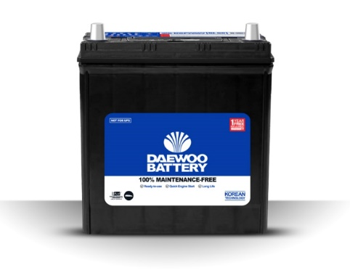
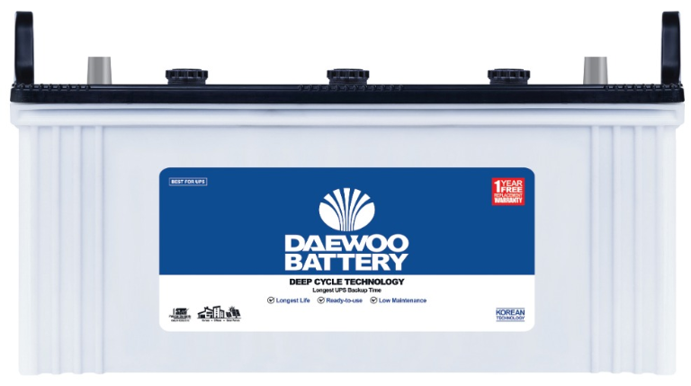
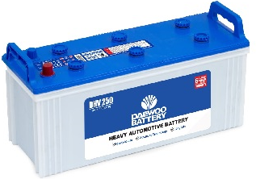
FTMM–Daewoo Battery Division
Daewoo Battery has successfully manufactured and launched Maintenance Free and Deep Cycle batteries in Pakistan and has become market leader in MF battery category within second year of operations.
100% Maintenance Free Battery Range
MF Battery Range: 28 Ah to 100 Ah
Revenue
4.9 Billion
Pak
Rupees
Certifications
ISO
9001:2015 &
14001:2015
Deep Cycle Battery Range
EB Battery Range: 80 Ah to 220 Ah
Resources
250+
Delighted
Employees
SKUs
27+
Batteries
Heavy Automotive Battery Range
Range: 85 Ah to 190 Ah

Slide 17
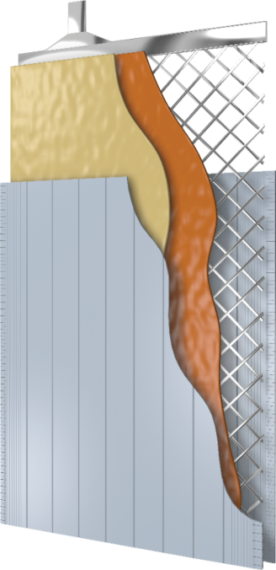
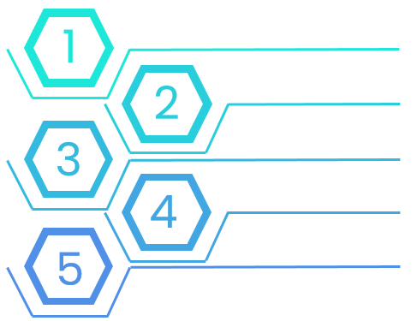
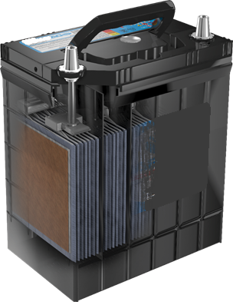
Car Batteries – Sealed ‘’100% Maintenance Free’’ Battery
New Expanded Grid Plate of Punch Type
  Pasted Cured Plates
Improves corrosion resistance
Ensures longer life at high temperatures.
Minimizes self discharge
Improves cold cranking.
Makes grid dimensions uniform and maximizes electrical flow.
Strong pasting of activity materials to prevent internal short circuit.
Enhances anti-vibration.
Microfiber and Special Tissue
  Envelope Separator for Low Electrical Resistance
Microfiber and Speci
Non woven fabric of polyester is applied in order to strongly support the activity material on the grid
Improves the starting power and ensures greater life cycle
Enhances Starting Power
Prevents Short Circuits on Plates
Improves Vibration Durability
1
Magic eye indicator
2
Sealed double cover with flame arrester
3
Various models are available from 28Ah to 100Ah for several vehicles from 650cc to 4,000cc
Advanced center lug technology and cast on strap
Optimized design of plate for battery capacity
4
Enveloped separator for low electrical resistance
5

Slide 18
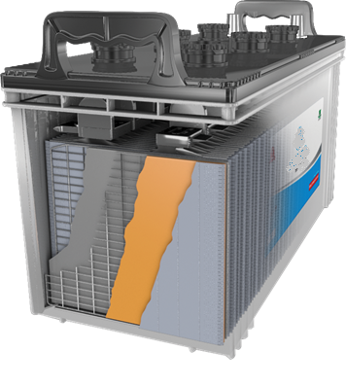
Storage Batteries for Solar Systems & UPS – Specialized Deep Cycle Battery
Weld System
Best in-class vent caps
Increases durability for extended life
Reduces leakage and corrosion for safer battery performance
Grid Manufacturing
Paste Formulation
Stamped grid technology
Extreme bond created by the formula improves overall performance and increases life
Rounded Corners
Robust Separators
Reduce internal shorts and extend battery life
Are stronger and more stable, leading to fewer battery failures due to short circuits
Several models available ranging from amperage 80Ah ~ 220Ah
Specially designed for Solar Systems and UPS. Deep discharge rate of Deep Cycle Technology battery gives the longest backup time and lasts longer than ordinary batteries
These specialized batteries come with 1 year Free Replacement warranty and is best suited for UPS/Solar Systems in homes, offices and industries.

Slide 19
FTMM– Product Wise Sale in Unit
Category | 2022 | 2021
Maintenance Free | 517,885 | 456,332
Deep Cycle | 100,487 | 104,913
Heavy Automotive | 61,792 | 21,556
Total | 680,164 | 582,801
100% Maintenance Free Battery Range
MF Battery Range: 28 Ah to 100 Ah
Deep Cycle Battery Range
EB Battery Range: 80 Ah to 220 Ah
Heavy Automotive Battery Range
Range: 85 Ah to 190 Ah

Slide 20
Market Share Analysis 22-23
Forecasted market Share of Daewoo Battery for the year 2022-23 is expected 11% of total market size of 8.1 M.
39%
10%
13%
13%
19%
6%

Slide 21
Last Two Years Profit or Loss - Battery

Slide 22
FTMM – Corrugation Division

Slide 23
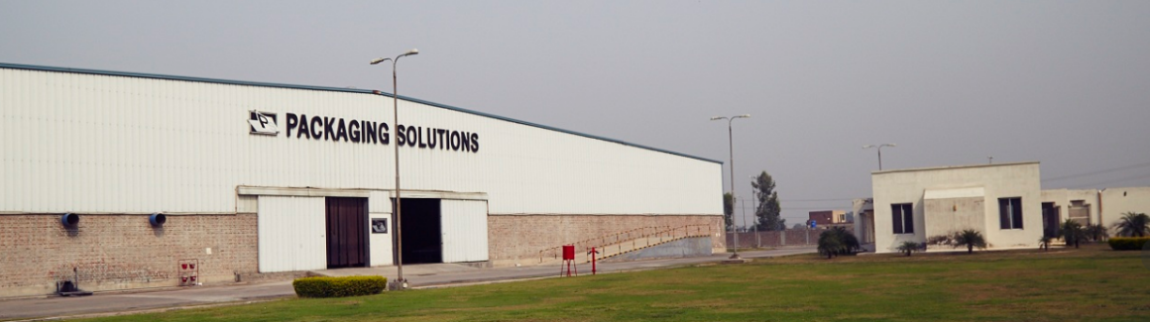
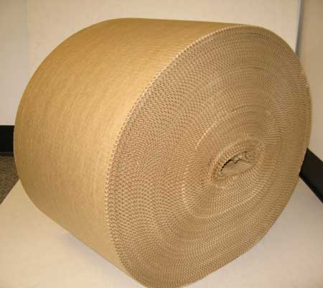
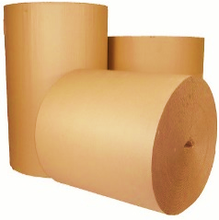
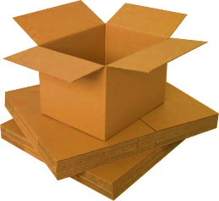
FTMM- Corrugation Division
1
2
3
4
Market Standing
Key Market Segments
Capacity & Certifications
Delighted Customers
Ranked amongst the top 5% box board plants in Pakistan
Dairy, Snacks, Home Appliances, Sports, Textile & many more having over 70% share in Lube Segment
Our ISO 9001 & FSSC 22,000 certified & SEDAX SMETA 4 PILLARS audited with production capacity of 2700 tons.
Nestle, Engro, PSO, Shell, Total, Pepsico, Lotte, Reckitt Benckiser, Tapal, Shan, Hilal etc

Slide 24

FTMM–Corrugation Division
Packaging Solutions (PACKSOL) is committed to manufacture high quality corrugated boxes to meet the growing demand of packaging solutions in the country. The products are benchmarked to agreed standards substantiated with personalized services to the valued clients at competitive price.
Revenue
2.3 Billion
Pak
Rupees
Resources
180+
Delighted
Employees
Certifications
ISO & FSSC
ISO 9001 &
FSSC 22,000
Portfolio
Industries
Textile, Home Appliances, Lube,
Dairy, Snacks, Beverages, etc

Slide 25
Last Two Years Profit or Loss – Corrugation

Slide 26
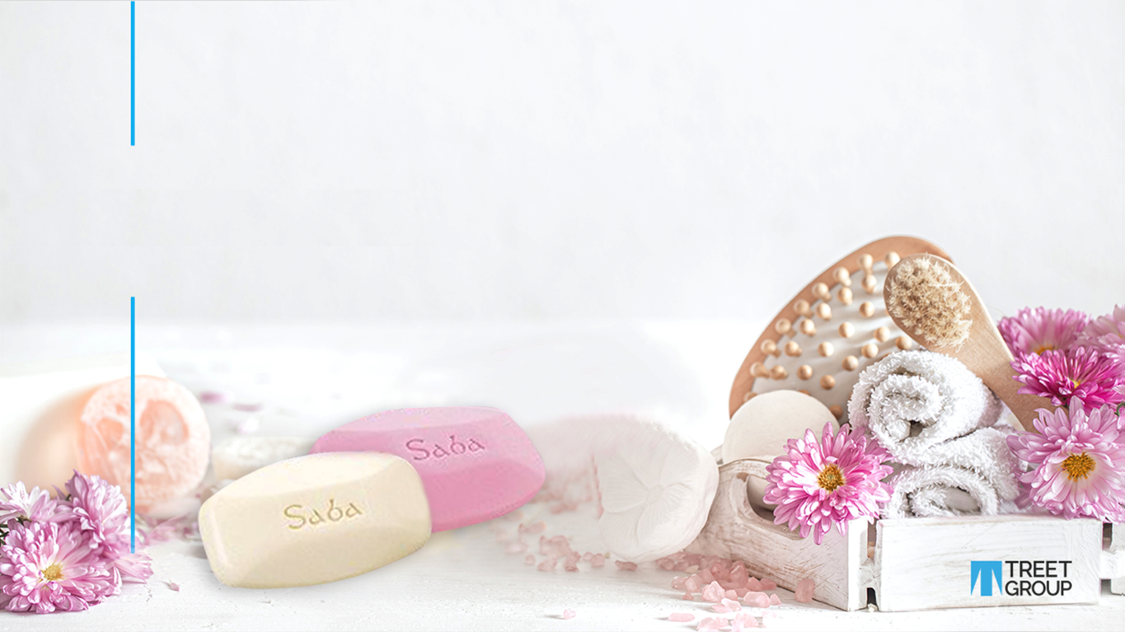
FTMM Soaps

Slide 27
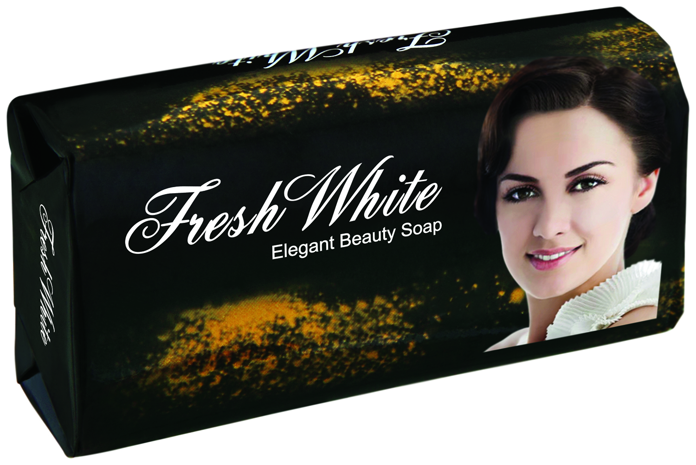
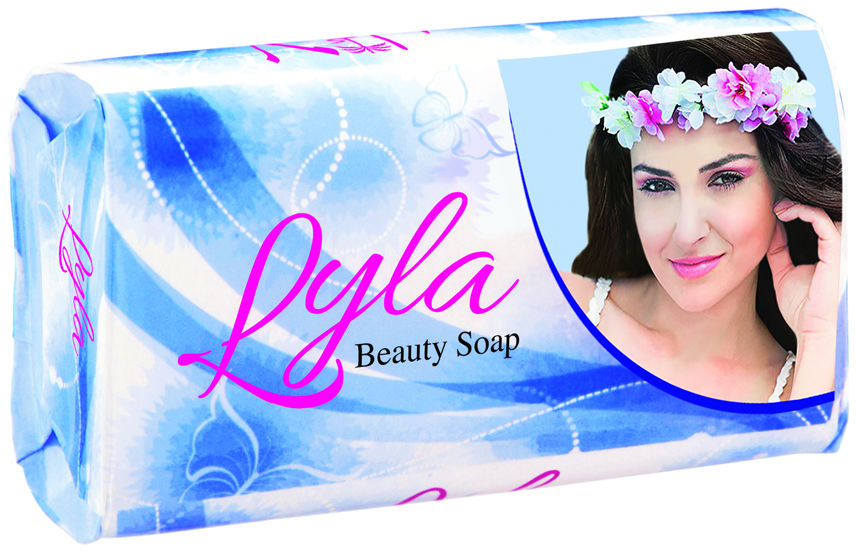
FTMM–Soaps Division
Treet Group started its soap operations in 1996 through toll manufacturing of Carbolic Soap in 1996 and commenced production of Laundry Soap in 1998.
Revenue
490 Million
Pak
Rupees
Distributors
477
Vast Distribution
Network
Certifications
PSQCA
Pakistan Standard Quality
Control Authority
Product
4 Brands
Saba, Fresh White, Bodyguard Family
& Lyla

Slide 28
FTMM-Soap Division
1996
Our Brands
Treet Group started its soap operations in 1996 through toll manufacturing of Carbolic Soap
Our four main soap brands Saba, Bodyguard Family, Fresh White & Lyla are being produced & marketed to cater to the demand of local market in Pakistan.
Strong Distribution Network
Our main brand, Saba soap is present in more than 400 towns throughout Pakistan and counted as one the favorites brand in masses.
1998
commenced production of Laundry Soap in 1998
Production Facility
Our current plan has annual production capacity of 5,000 tons and our products are certified by Pakistan Standard Quality Control Authority (PSQCA).
2005
Leased a soap plant and started its soap operations under Treet Group’s direct management control

Slide 29
Last Two Years Profit or Loss – Soap

Slide 30
Renacon Pharma Limited

Slide 31
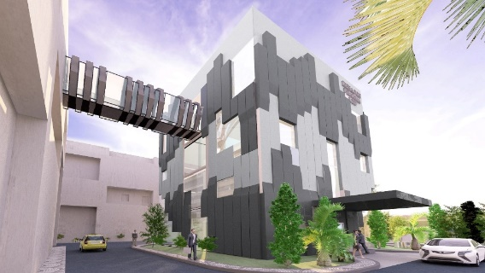
Renacon Pharma Limited
RPL is the pioneer producer and market leader of Bicarbonate Hemodialysis concentrate of all types in Pakistan since 1997. RPL also launched RenaCare (Hand Sanitizers) & RenOxid (Disinfectants).

Slide 32
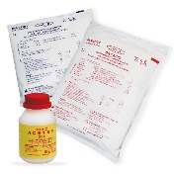
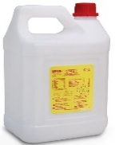
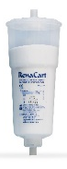
Renacon Pharma Limited
RPL is the pioneer producer and market leader of Bicarbonate Hemodialysis concentrate of all types in Pakistan since 1997. RPL also launched RenaCare (Hand Sanitizers) & RenOxid (Disinfectants).
Product Line
Plant Certifications
Special powder formulations, Cartridge, Bi Bags, Dialysis disinfectant, Salt tablets for water softener, etc.
ISO 9001, ISO 13485, CE0120 since 2007 through SGS, UK.
Global Standing
Export Presence
RPL is considered among the top 25 companies producing Hemodialysis Concentrates in the World as per global market intelligence reports
Exporting to Sri Lanka, Philippines, Kenya, Ethiopia. Madagascar, Bangladesh, Malaysia & Afghanistan.

Slide 33
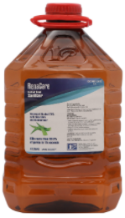
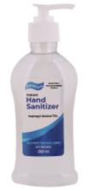
Renacon Pharma Limited
Our existing plant capacity is around 2.4 M hemodialysis sessions per year which will be increased to 15.3 M sessions per year with the commissioning of our New Plant which is being built on 2-acres in FIEDMC ,Pakistan.
Revenue
715 Million
Pak
Rupees
Capacity
2.4 Million
Hemodialysis
Sessions Material
Resources
90+
Delighted
Employees
Certifications
ISO
9001 &13485
& CE 0120

Slide 34
Last Two Years Balance Sheet – Renacon

Slide 35
Last Two Years Profit or Loss – Renacon

Slide 36
Consolidated Financials

Slide 37
Last Two years Segment Wise Sale

Slide 38
Last Two Years Balance Sheet – Consolidated

Slide 39
Last Two Years Profit or Loss – Consolidated

Slide 40
Plant Capacity and Production
Plant | Units | Capacity | Actual - 2022 | Actual - 2021 | Utilization (%) - 2022 | Utilization (%) - 2021
Hemodialysis concentrates | In Thousand | 2,400 | 2,294 | 2,189 | 95.58% | 91.21%
Blades | In Millions | 2,230 | 1,721 | 2,094 | 77.17% | 93.90%
Corrugated boxes | In Metric Tones | 30,000 | 23,578 | 20,513 | 78.59% | 68.38%
Batteries | Numbers | 1,200,000 | 672,711 | 575,009 | 56.06% | 47.92%
Soap | In Metric Tones | 5,000 | 1,464 | 2,780 | 29.28% | 55.60%
Bikes | In Units | 18,000 | 1,245 | 677 | 6.92% | 3.76%

Slide 41
Employee Headcount at year end 2022
Entity | Headcount
Treet Corporation Limited | 2,119
Treet Holdings Limited | 24
First Treet Manufacturing Modaraba | 441
Renacon Pharma Limited | 90
Total | 2,674

Slide 42


Slide 43

TREET GROUP
Plan 2022-23
01
REPROFILING of SHORT TERM BPRROWING
Short term borrowing has been reprofiled to long term loan amounting to Rs 1.5 billion, however due to certain regulatory approvals pending at the reporting date, the disbursement of long term loan and repayment of short term loan was carried out during the month of July 2022.
02
SPIN OFF the BATTERY SEGMENT
Spin off the battery segment from Modaraba into a separate company (Treet Battery Limited).
03
FURTHER CAPACITY ENHANCEMENT – HYGIENE RAZOR
After enhancement of the hygiene razor capacity by 16% during FY 2022. Further capacity is also being evaluated considering the high demand of Hygiene razors.
04
CAPACITY ENHANCEMENT – RENACON
New production facility of Renaocn at FEDMIC is underway, completion is expected in FY 2023.. This production facility will enhance the production capacity from 2.4 million to 17.4 million sessions. Estimated cost to complete the project is 1,043 million.

Slide 44
FIRST TREET MANUFACTURING MODARABA - FTMM
Plan 2022-23
01
DELEVERAGING AND DEBT REPROFILING
  Current level of borrowing is Rs. 5.6 bn – Rs. 3 bn from banks and Rs. 2.6 bn from Treet
  Spin off battery segment is in its final stages at the Lahore High Court and the matter is fixed for hearing on Jan 10, 2023. We are hopeful that on the said date the de-merger of FTMM will be sanctioned, by the High Court.
  After spin off the battery segment, public offering of new battery Company to raise funds.
02
BUSINESS PLANNING
  Revised costing to create more margin
  Retail price revisions
  Increase plant reliability through preventive maintenance strategy
  Increase sales volume through improved market planning
  New opportunities with upcoming car OEMs.

Slide 45
RENACON PHARMA LIMITED
Plan 2022-23
RESUMPTION OF WORK ON NEW FACILITY
  Capacity enhances by 7 time. Approximately 10 to 11 months required to complete the project expected completion date is June 2023
  Additional capacity will primarily cater export market
  Financing arrange through private equity participation and through TERF
  Public offering after COD

Slide 46
THANK YOU!

